Slide 1
NLP – Review Classification
EDA and K Nearest Neighbors Model
Name - Abhishek Swaroop Shrivastava
Branch – CSE
College – KIET Group of Institutions
Project – 3
Group - 26

Slide 2
Exploratory Data Analysis (EDA)
It refers to the critical process of performing initial investigations on data so as to discover patterns , to spot anomalies , to test hypothesis and to check assumptions with the help of summary statistics and graphical representations.
It is for seeing what the data can tell us beyond the formal modeling or hypothesis testing task.
The goal of EDA is to obtain confidence in the data to a point where a person is ready to engage a machine learning algorithm.

Slide 3
Steps involved in EDA
Gain information about data
Check for missing values
Obtain shape of dataset
Obtain maximum insight of the dataset with certain visuals.

Slide 4
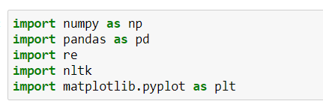
Libraries Used
Numpy – It is used to perform number of mathematical operations on arrays.
Pandas – It provides easy to use structures and data analysis tools.
re – It provides a set of powerful regular expression facilities , which allows us to quickly check whether a given string matches a given pattern.
NLTK – It supports tasks such as classification , stemming , etc.
Matplotlib – It is a plotting library that allows us to draw histograms , bar graphs , etc.

Slide 5

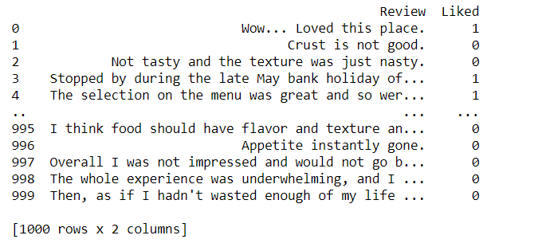
Importing the dataset
The dataset is imported using read_tsv( ) method .
Our dataset contains 1000 rows and 2 columns

Slide 6
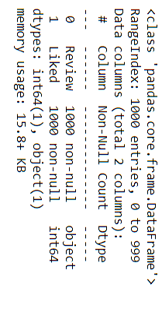

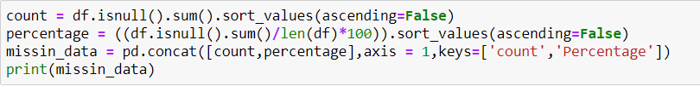

EDA Techniques involved in making the project.
1. Obtaining information about our dataset
2. Checking our dataset for missing values

Slide 7


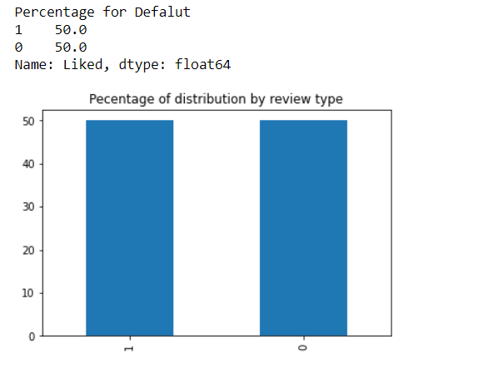
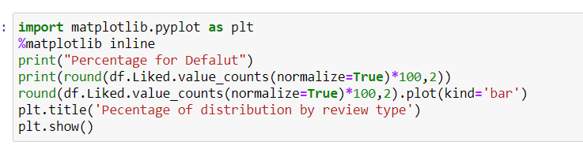
3. Shape of our dataset
4. Obtaining percentage of reviews labelled as 0 or 1

Slide 8
K Nearest Neighbor (KNN)
K-Nearest Neighbors (KNN) is one of the simplest algorithms used in Machine Learning for regression and classification problem.
KNN algorithms use data and classify new data points based on similarity measures (e.g. distance function). Classification is done by a majority vote to its neighbors.
KNN works by finding the distances between a query and all the examples in the data, selecting the specified number examples (K) closest to the query, then votes for the most frequent label (in the case of classification) or averages the labels (in the case of regression).

Slide 9
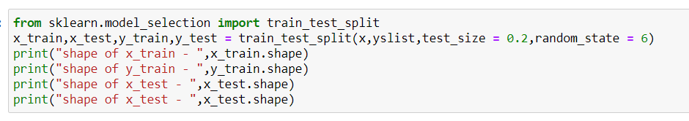

Train/Test Splitting
After refining our data , i.e., after removing the stopwords , punctuations and unnecessary spaces we split our data set into training and testing set by using train_test_split function of sklearn.model_selection.

Slide 10

Creating KNN Model
After obtaining our train and test split we are ready to create our KNN Model. First we import KNeighborsClassifier from sklearn.neighbors and then we make can object knn which will be further called to access the functions of KNeighborsClassifier class.

Slide 11
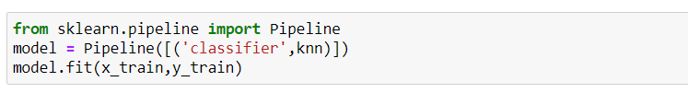

Creating Pipeline and Predicting the Output (y)
A machine learning pipeline is used to help automate machine learning workflows .They operate by enabling a sequence of data to be transformed and correlated together in a model that can be tested and evaluated to achieve an outcome , whether positive or negative.
Predicting our output that will be further used to calculate the accuracy of our model on the test set.

Slide 12
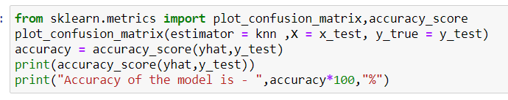
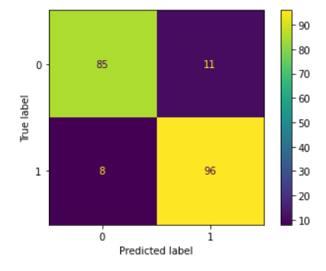

Accuracy(accuracy_score) and Confusion Matrix
Calculating accuracy_score and plotting Confusion Matrix to evaluate the performance of our model -

Slide 13
Conclusion
With the help of Exploratory Data Analysis we were able to determine the insights of our dataset and various ‘Text Pre-processing’ techniques required to make our model perform well on our dataset.
With the help of K Nearest Neighbor algorithm we are able to classify the reviews in our dataset as ‘Liked’ or ‘Dis-liked’ and we got an accuracy of 90.5% using our KNN model.
We have performed the same classification of reviews with two other models also , i.e. , Support Vector Machine (SVM) and Support Vector Machine with Principal Component Analysis (SVM with PCA) . These two modes also performed well on our dataset and we got a good accuracy of about 90.5%.

Slide 14
Thank You

